Slide 1


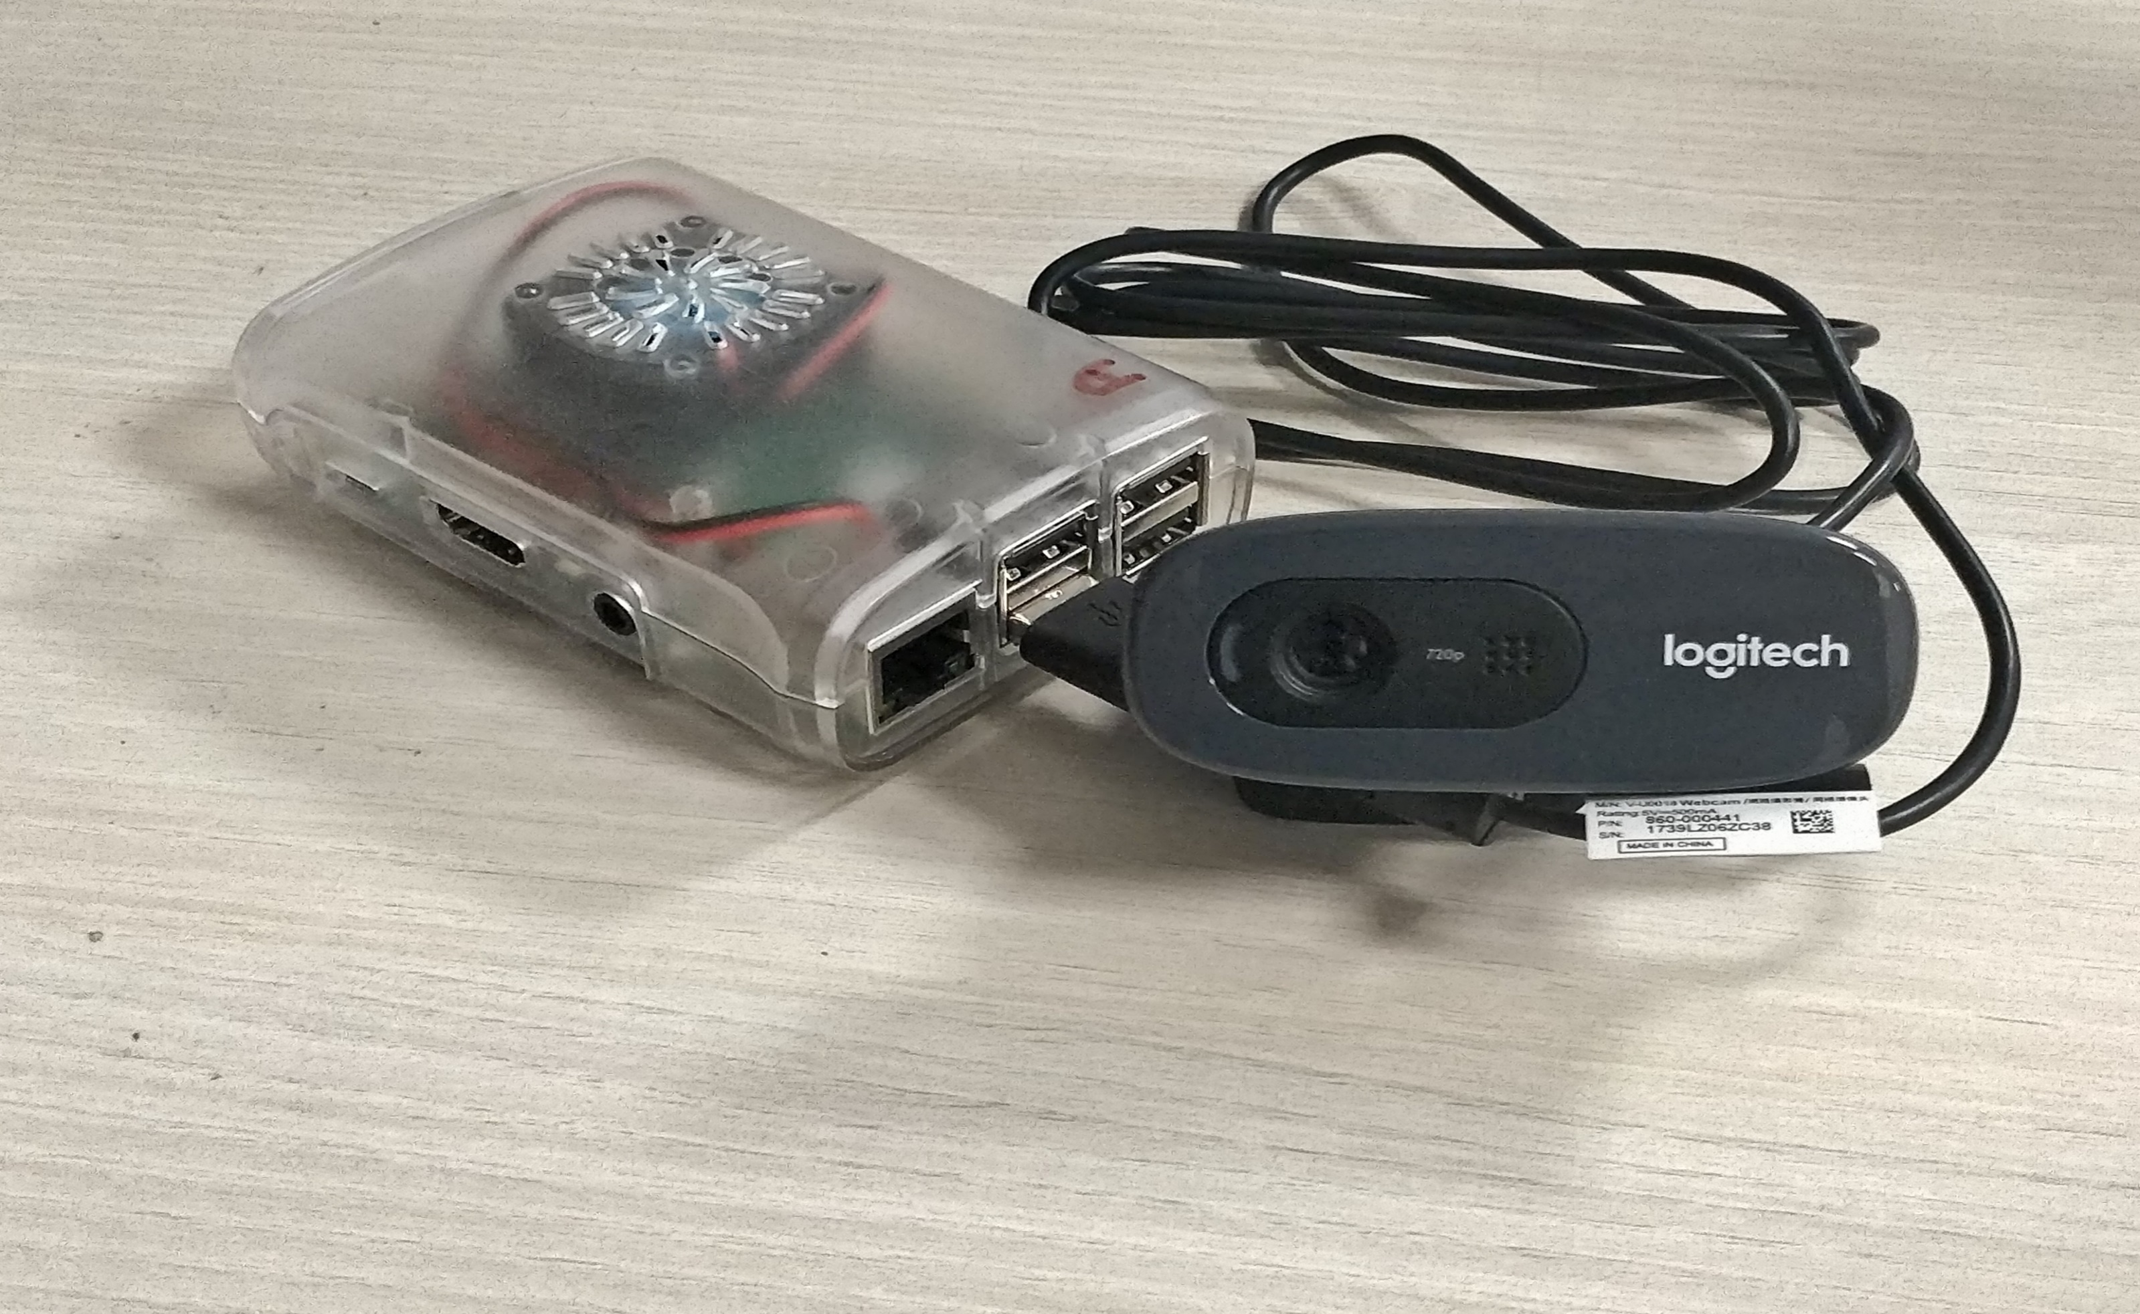
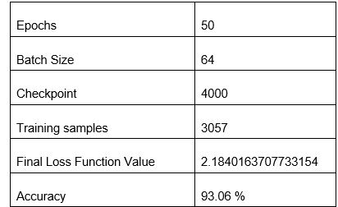
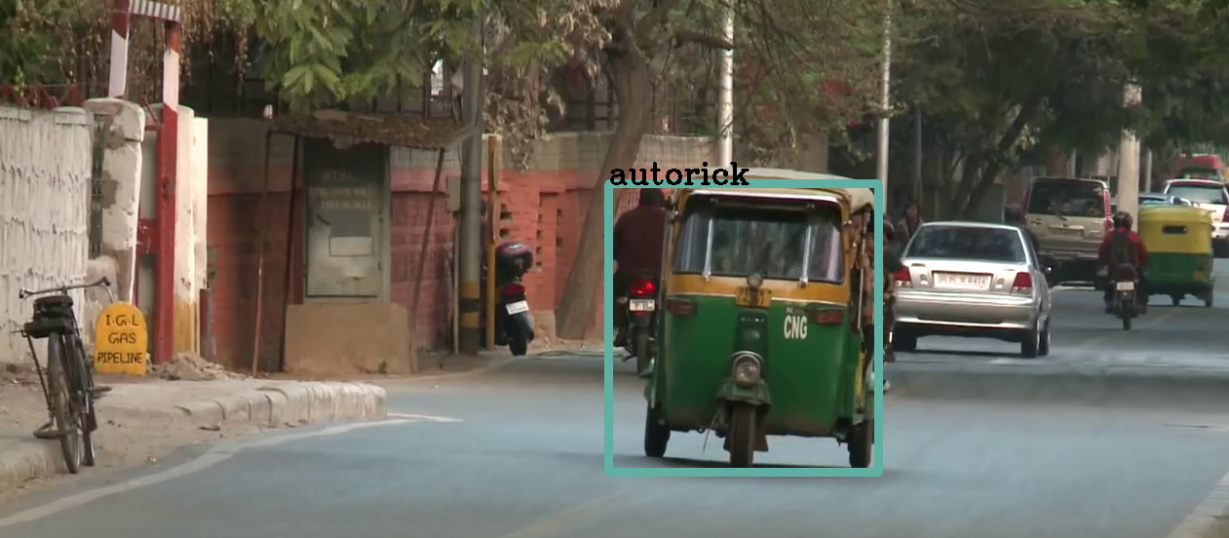
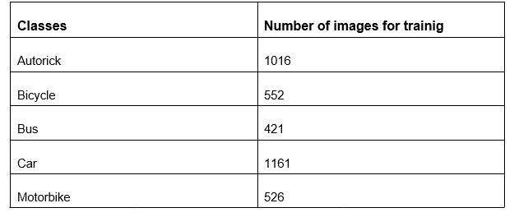

REAL TIME VEHICLE CLASSIFICATION AND LOCALIZATION USING
AGE COMPUTING
[Rahul Krishnan Swapnil Panwala Akhil John]
[Dr.Vipul Mishra]
Abstract
.
The project aims at detecting and classifying relevant objects in a video stream (Surveil-
lance Video) in real time. The project is a step forward in the era of Edge Computing, by delivering a fully functional and independent end-user device, such as the Pi. We discuss in length the progress made leading up to the current development scene and possible future enhancements that can serve as motivation for further work. We study various working models and further divulge into the chosen model with a discussion on the steps involved for the same.
Introduction
Our project is an extended work on the blooming Computer Vision work on vehicle detection. We implement a real-time system capable of accounting to vehicles in-and-out of subjected areas. Most notable and recent work in the industry has been credited to models trained on the western context, with subtle yet significant changes in contrast with the Indian context.
Our model will finally be executed in a low spec device, the Raspberry Pi3 and all further correspondence to our project is parallel with implementation of the same in Pi.
Most exhaustively used models include ResNet and the YOLO model. Both of which has significant accuracy, but again with the western context. We lean towards the two as they have superior localization and classification in addition to easier modification of layers, via transfer learning. We further seek to implement a fully functional system trained on indian vehicles. Our expected levels of accuracy and threshold values are mentioned in later parts of the report
Proposed Method
1)Initial Idea: ResNet with Embedded Learning Library- Microsoft.
[CON] Cannot be of appreciable size to be compactible with Pi.
2) Final Implementation: Tiny YOLOv2 Implementation by Dark-flow. (VOC data-set)
[PRO]
Tiny YOLO reduces total space consumption by around 35% with negligible loss in accuracy or correctness of prediction
Experimental Results and Discussion
Conclusions
The main inspiration behind this project was our observation of guards maintaining manual records of vehicles entering or leaving the University campus. We found a need to automate this process of maintaining records. A device could be made that could take accurate records not only at gates but also at different locations. The data collected from such devices, over some months or years could give insight into people’s activity and the growth of a city. For better execution of our model, the code could be further optimised by removing the dependencies not required for execution of real-time processing. Further the model could be also trained for number plate detection to get precise data for surveillance. This would not only result to higher precision but we would be able to collect more data.
References
https://www.pyimagesearch.com/2016/11/14/installing-keras-with-tensorflow-backend/
2) https://github.com/Microsoft/ELL/blob/master/INSTALL- Windows.md
Team No. - 2

